Slide 1
Country
Ethnicity
Gender

Slide 2
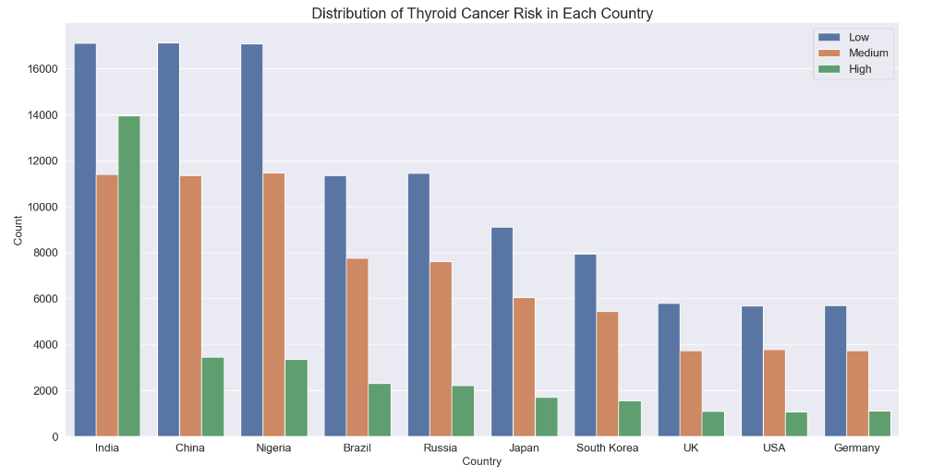

Slide 3
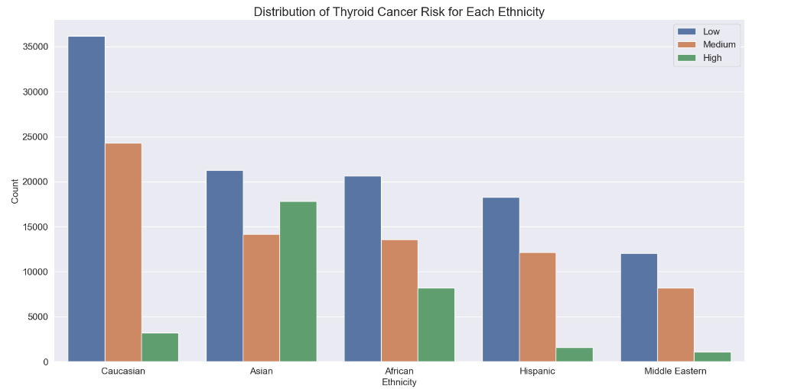

Slide 4
